Slide 1
Traffic simulation in the city of Zurich
Lecture with Computer Exercises:
Modelling and Simulating Social Systems with MATLAB
FS 2014
Lecturers Authors
Dario Biasini, Dirk Helbing, Jan Dörrie, Simone Forte,
Tobias Kuhn, Olivia Woolley Charalampos Gkonos, Athina Korfiati

Slide 2
Table of Contents
General Motivation
Introduction & Fundamental Questions
Data Processing
Description of the Model
Simulation Results
Conclusions

Slide 3
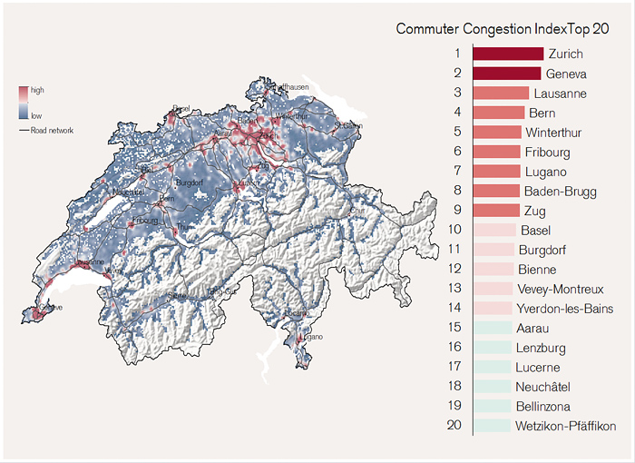
General Motivation
Credit Suisse, 2014. Morning Traffic Congestion in Switzerland – the Commuter Congestion Index. [Online] Available at: https://www.credit-suisse.com/publications/one-articles/news-and-expertise/2014/03/en/zurich-and-geneva-need-road-pricing/_jcr_content/articleContent/articleinsertcontain/clusters/articleimagezoomelem.zoom.html [Accessed 17 May 2014].

Slide 4
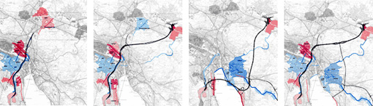
Introduction & Fundamental Questions
Highway Tunnel Zürich Project
(proposed by the ARGE Züriring consortium)
Will the construction of a tunnel eventually improve or worsen the traffic situation?
Güller Güller Architecture Urbanism, 2002. Highway Tunnel Zürich. [Online] Available at: http://www.ggau.net/html/GG03.html [Accessed 2 March 2014].

Slide 5
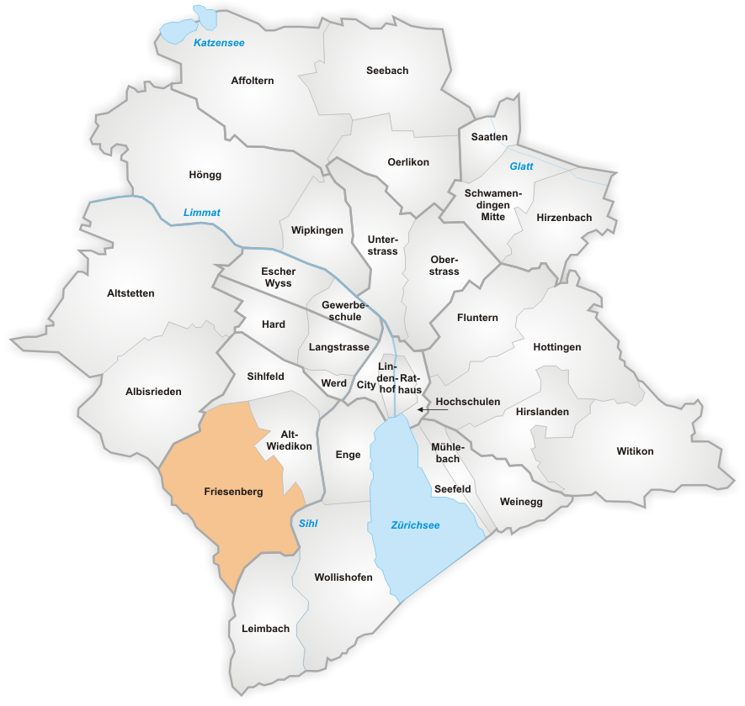
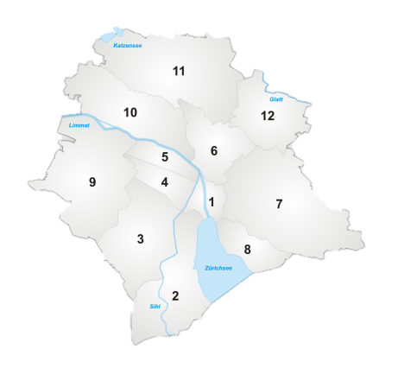
Trip Generation Points
Municipality of Zürich
12 Districts
34 Neighbourhoods
Population Data
District to Neighbourhood
Wikipedia, 2008. Subdivisions of Zürich. [Online] Available at: http://en.wikipedia.org/w/index.php?title=Subdivisions_of_Z%C3%BCrich&oldid=603437314 [Accessed 2 March 2014].

Slide 6
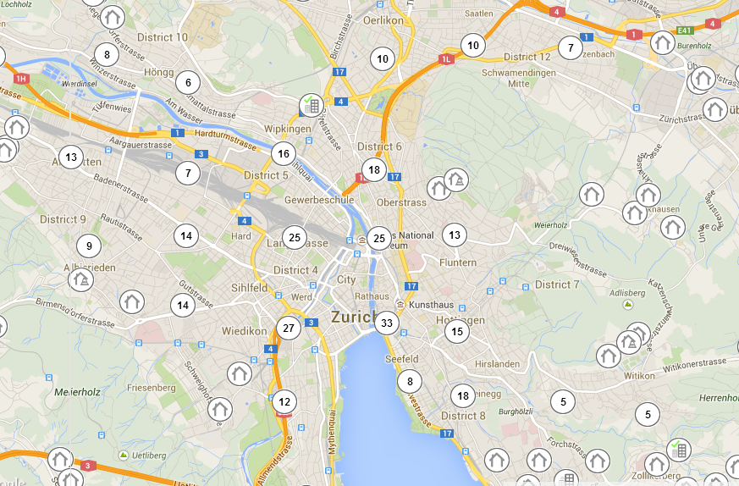
Destination Points
Companies Data
Coordinates of Clustering Points
40 Destination Points
Money House, 2014. Trade register data and business information. [Online] Available at: http://www.moneyhouse.ch/en [Accessed 2 March 2014].

Slide 7
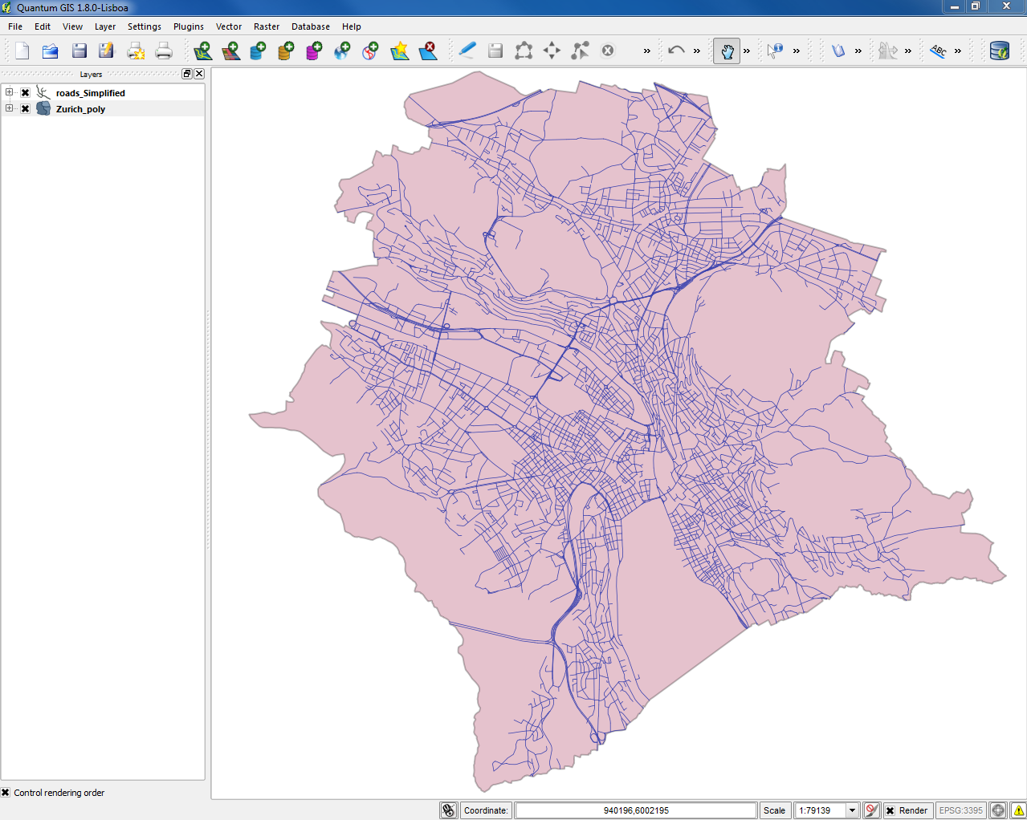


Simplified Road Network
OpenStreetMap data from “weogeo”
Processing with Quantum GIS

Slide 8
The traffic model
Trips generation
Route selection
Journey execution
Jan Dörrie, Simone Forte, Charalampos Gkonos, Athina Korfiati
19.05.2014
8

Slide 9
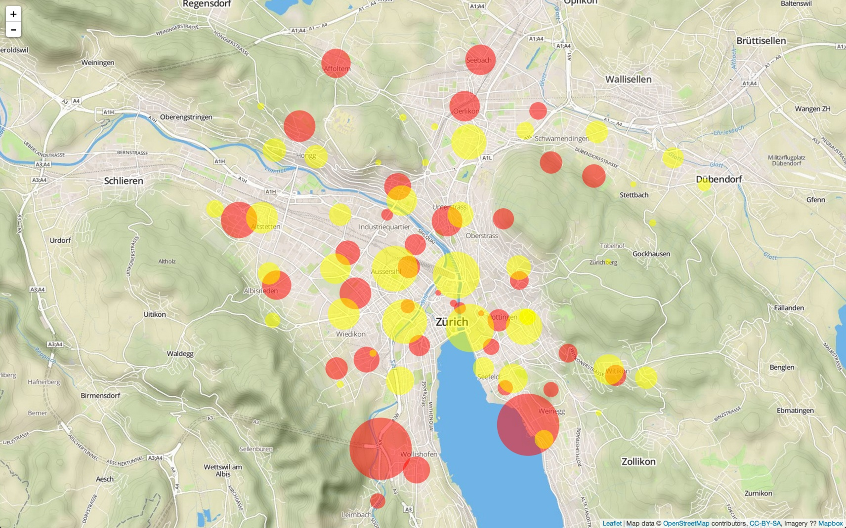
Trips generation
Jan Dörrie, Simone Forte, Charalampos Gkonos, Athina Korfiati
19.05.2014
9

Slide 10
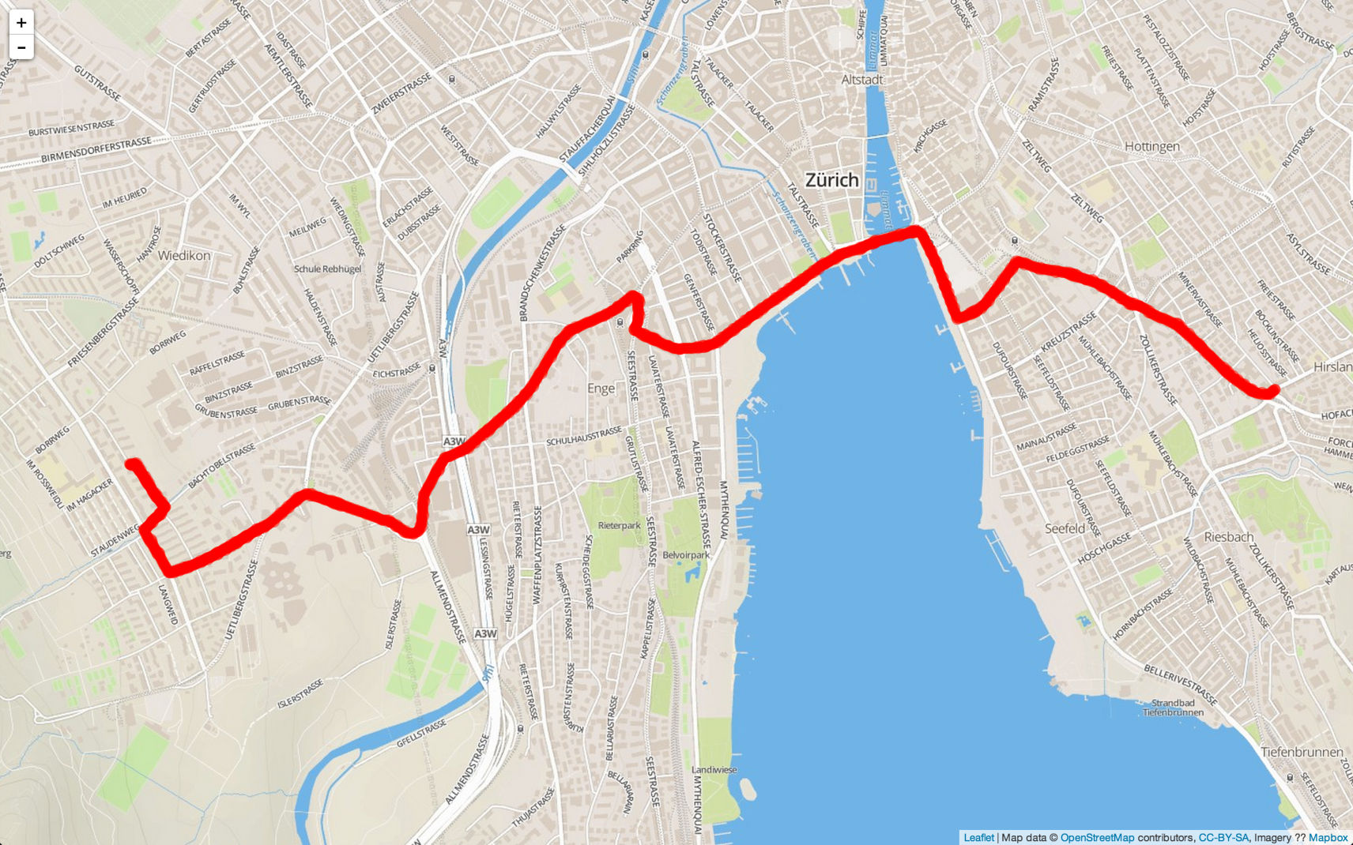
Route selection
Jan Dörrie, Simone Forte, Charalampos Gkonos, Athina Korfiati
19.05.2014
10

Slide 11
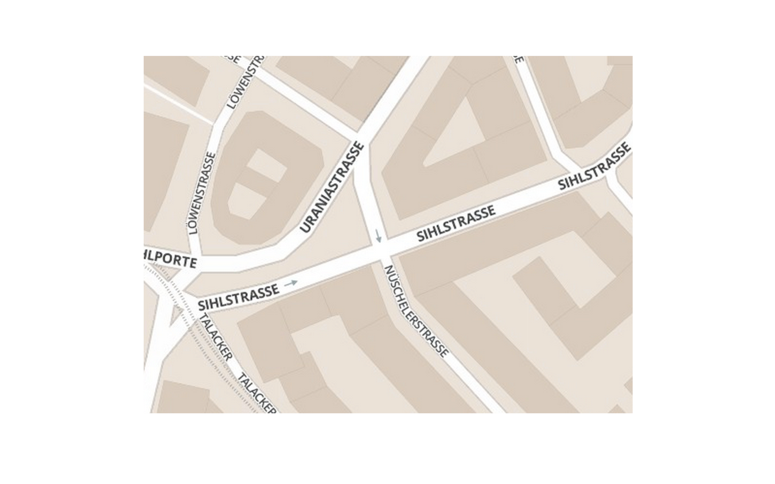
Journey execution
Jan Dörrie, Simone Forte, Charalampos Gkonos, Athina Korfiati
19.05.2014
11

Slide 12
Journey execution
Jan Dörrie, Simone Forte, Charalampos Gkonos, Athina Korfiati
19.05.2014
12

Slide 13
Journey execution
Jan Dörrie, Simone Forte, Charalampos Gkonos, Athina Korfiati
19.05.2014
13

Slide 14
Journey execution
Jan Dörrie, Simone Forte, Charalampos Gkonos, Athina Korfiati
19.05.2014
14

Slide 15
Journey execution
Jan Dörrie, Simone Forte, Charalampos Gkonos, Athina Korfiati
19.05.2014
15

Slide 16
Journey execution
Jan Dörrie, Simone Forte, Charalampos Gkonos, Athina Korfiati
19.05.2014
16

Slide 17
Journey execution
Jan Dörrie, Simone Forte, Charalampos Gkonos, Athina Korfiati
19.05.2014
17

Slide 18
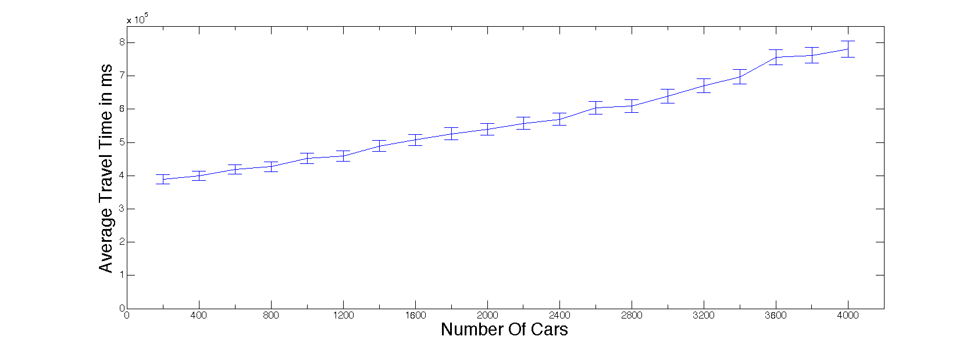
Simulation Results
Increase of number of cars increases travel time

Slide 19
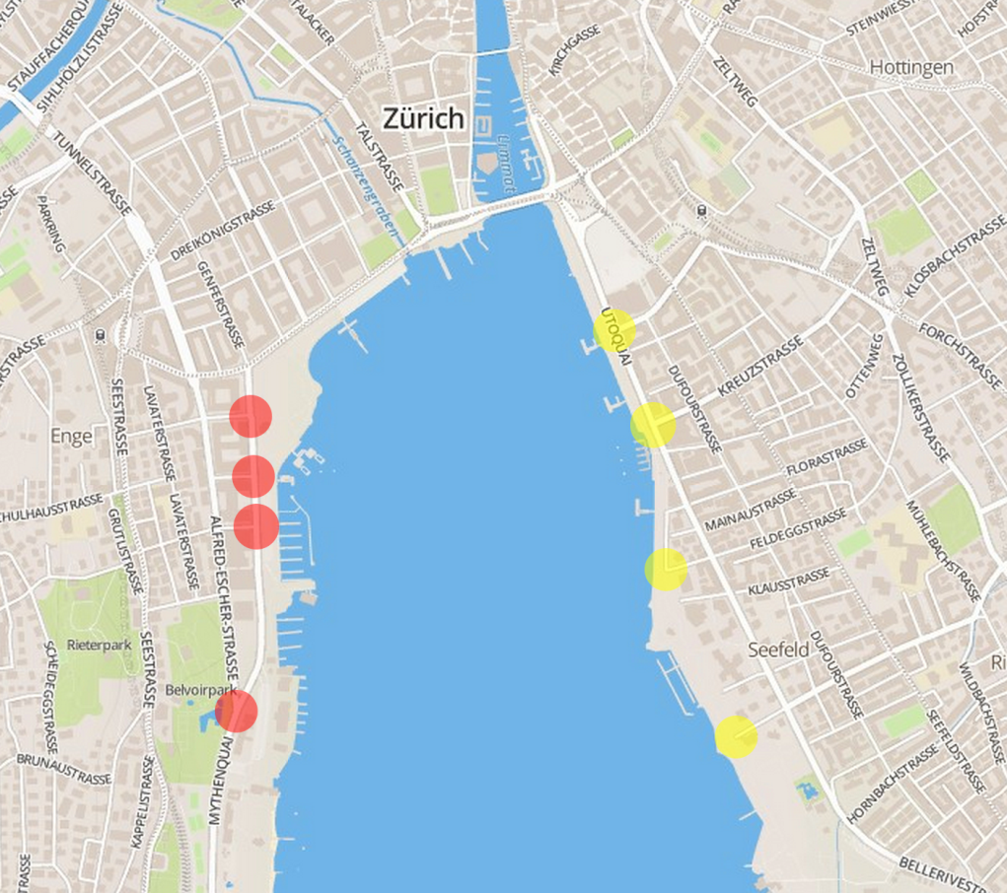
Simulation Results
16 possible positions for the tunnel were considered

Slide 20
Simulation Results
start node | end node | 500 cars | 1000 cars | 2000 cars
Left 1 | Right 1 | 398570 | 447040 | 576070
Left 1 | Right 2 | 419070 | 444740 | 542180
Left 1 | Right 3 | 410970 | 453580 | 564700
Left 1 | Right 4 | 404440 | 441430 | 541860
Left 2 | Right 1 | 420470 | 453320 | 544150
Left 2 | Right 2 | 423860 | 443500 | 533280
Left 2 | Right 3 | 421850 | 435940 | 539880
Left 2 | Right 4 | 399220 | 450070 | 555110
Left 3 | Right 1 | 409720 | 441690 | 527970
Left 3 | Right 2 | 414000 | 447560 | 520660
Left 3 | Right 3 | 393170 | 447390 | 536280
Left 3 | Right 4 | 401790 | 443810 | 553050
Left 4 | Right 1 | 417620 | 440940 | 553870
Left 4 | Right 2 | 424000 | 440600 | 533280
Left 4 | Right 3 | 407270 | 439130 | 531330
Left 4 | Right 4 | 412490 | 441830 | 536610
---- | ---- | 400872 | 471644 | 545545

Slide 21
Conclusion
Every tunnel improved results for 1000 cars
Hard to say which tunnel is best in general
Change to no tunnel is not significant for 500 and 2000 cars

Slide 22

Thank you for your attention!!
Questions?

